Slide 1

Cyclistic Bike Share Analysis: A Deep Dive into User Patterns
This presentation explores the usage patterns of Cyclistic's bike sharing system, comparing annual members and casual riders. We aim to uncover key insights to guide marketing strategies and drive future growth.

Slide 2
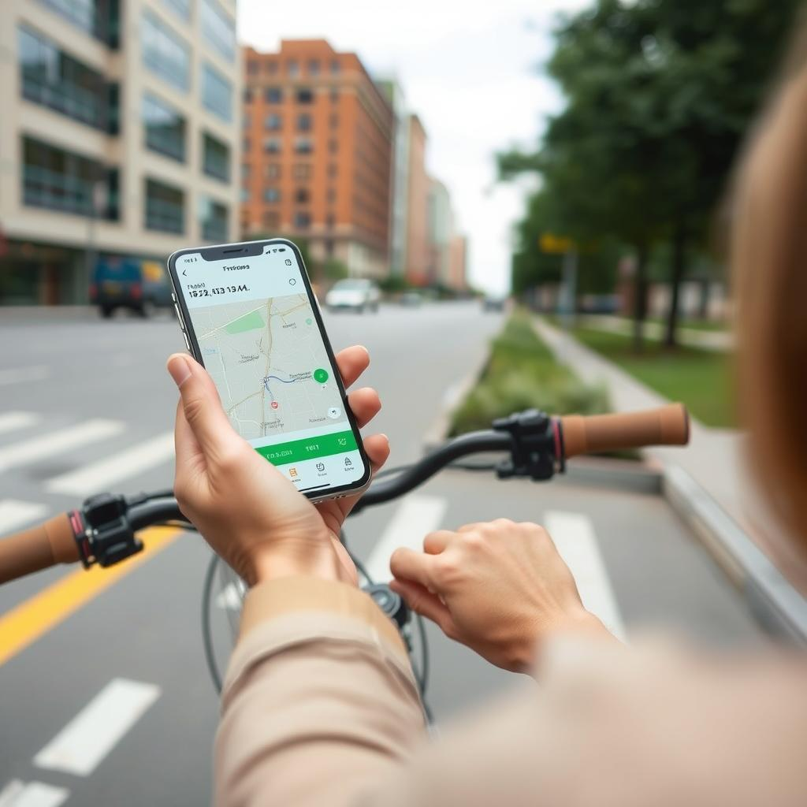


Understanding User Patterns: Annual Members vs. Casual Users
Problem
Cyclistic offers various membership options, but they seek to understand the distinct usage patterns of annual members and casual users.
Objective
This analysis aims to examine usage patterns by user type to inform effective marketing strategies for converting casual users into members.

Slide 3

Data Description: A Deep Dive into Our Dataset
1
Data Period
2
Data Mass
The dataset spans October 2023 to October 2024, encompassing a full year of Cyclistic bike usage.
The dataset is comprehensive, including information on user type, station locations, trip durations, and other vital details.
3
Data Consistency
4
Tools Used
Data quality was ensured through thorough checks for duplicates and missing values, resulting in a reliable analysis.
This analysis leveraged powerful tools such as R, BigQuery, and Tableau for data manipulation, analysis, and visualization.

Slide 4
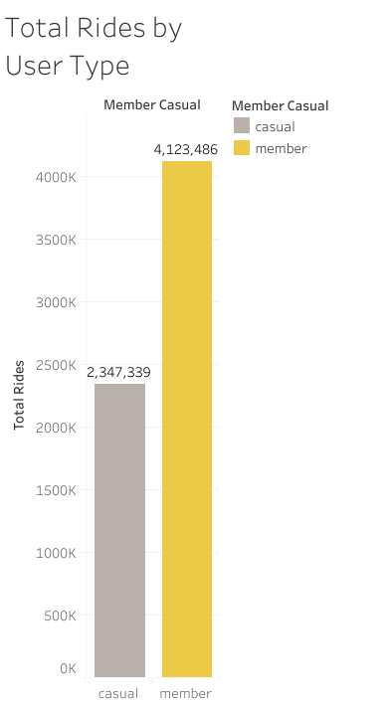
Usage per User Type: Unveiling the Patterns
4.1M
2.3M
Member
Casual
Annual members have significantly more rides than casual users, indicating a higher level of engagement with the service.
The majority of users are members, representing approximately 64% of the total. This indicates good user retention and successful loyalty strategies.

Slide 5
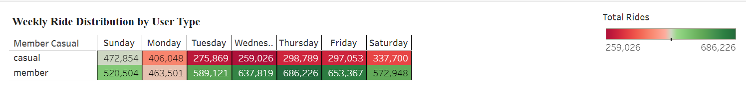
Daily Usage Patterns: Understanding Weekly Trends
Weekday Usage
Peak Ride Days
Both member and casual users exhibit distinct patterns. Members have consistent usage throughout the week, while casual riders peak on weekends.
The total number of rides is highest on Sunday (993,358), followed by Thursday (985,015). This may indicate that the service is popular both for leisure activities on weekends and for commuting during the week.

Slide 6
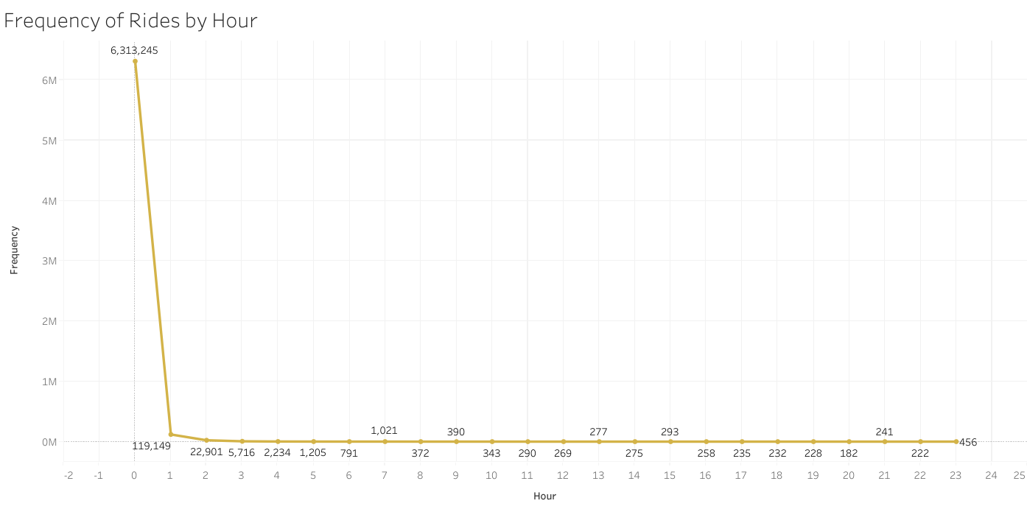
Frequency of Rides by Hour
The highest frequency of rides occurs at midnight (hour 0) with 6,313,245 rides, likely due to system resets or end-of-day processing. Ride frequency increases from hour 7, indicating significant morning commute usage. The lowest frequency is between hours 4 and 6, with the lowest at hour 5 with 1,205 rides. Understanding this pattern helps optimize service availability and improve user experience.

Slide 7
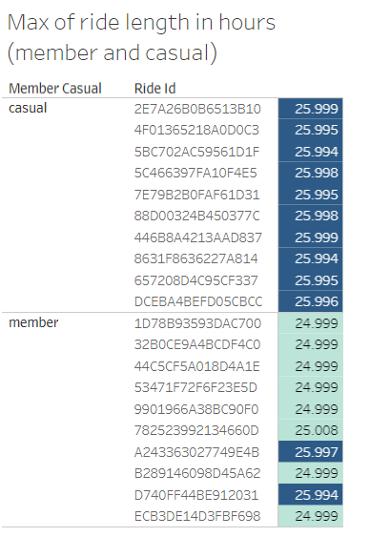
Maximum Ride Length Analysis
The data suggests unusually long ride times that likely indicate errors or anomalies. It's important to validate and clean the data to ensure accurate analysis and insights.

Slide 8
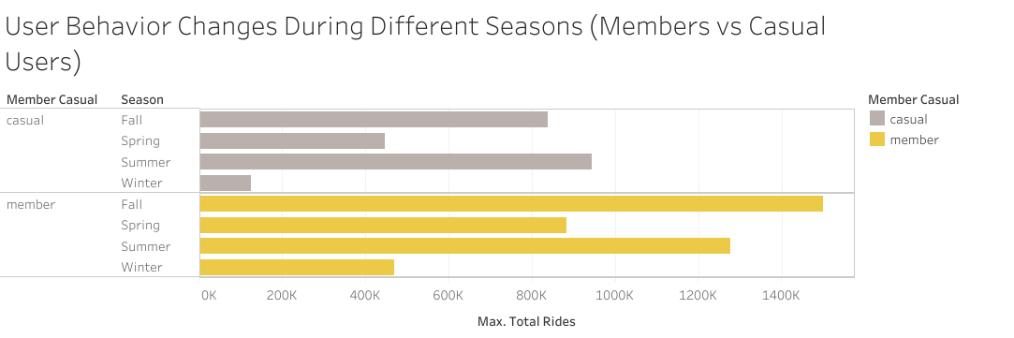
User Behavior During Different Seasons (Members vs Casual Users)
The highest number of rides for both groups occurs in summer, indicating a peak in usage during this season. Members have significantly more rides in all seasons, suggesting a strong loyalty and regular usage pattern among them.Casual users also show increased activity in summer and fall, likely due to favorable weather conditions.

Slide 9
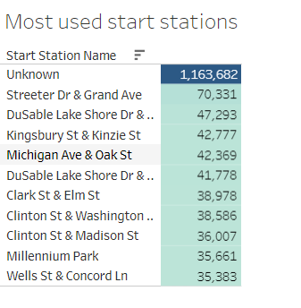
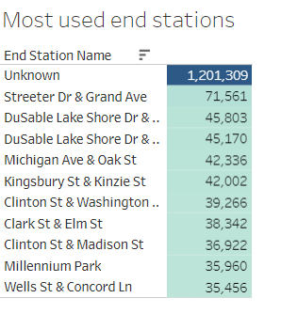
Daily Usage Patterns: Understanding Weekly Trends
High Usage
Popular Stations
The "Unknown" station has an exceptionally high number of rides, which may indicate data recording issues or a large number of unregistered start locations.
The most popular stations are located in central and high-traffic areas, indicating their importance for commuting and leisure activities.

Slide 10

Key Findings and Recommendations:
Popular Stations: The most popular stations are located in central, high-traffic areas, highlighting their importance for commuting and leisure activities.
Annual Members' Engagement: Annual members take significantly more trips than casual users, indicating a higher level of engagement with the service.
User Retention: Members constitute approximately 64% of the total users, reflecting successful user retention and loyalty strategies.
Usage Patterns: Members show consistent usage throughout the week, while casual users have peak usage on weekends.

Slide 11
Recommendations for the Marketing Team:
Convert Casual Users to Annual Members: Encourage casual users to become annual members by highlighting the benefits of consistent use and loyalty advantages.
Weekday Usage Campaigns: Focus on marketing campaigns that promote weekday usage for casual users, potentially converting them into annual members.

Slide 12
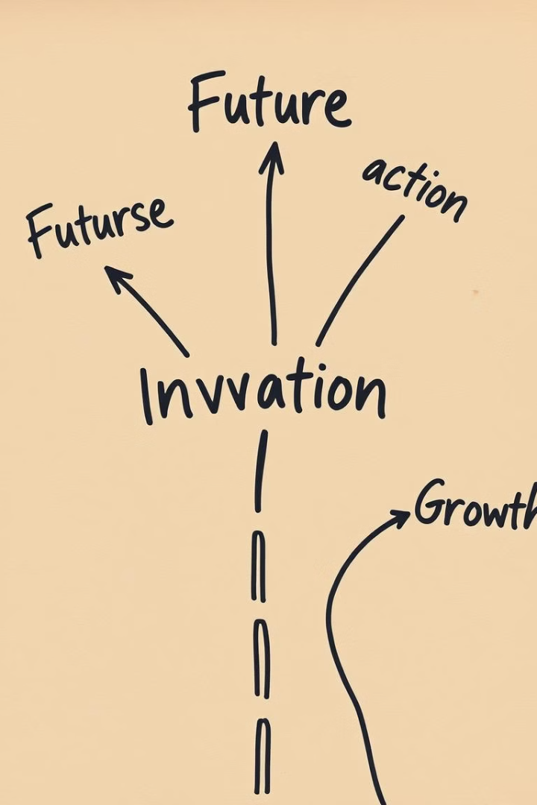
Suggestions for Future Analysis and Data Collection Improvements
Conduct a deeper analysis of user demographics and trip characteristics to gain more detailed insights.
Enhance data collection to include user feedback on their experiences and preferences.
Develop targeted campaigns to increase weekday usage among casual users.
Create loyalty programs that encourage casual users to transition to annual memberships by highlighting long-term benefits.

